Slide 1
Data Structures: Priority Queues
24/05/2023
Charvi Mehra

Slide 2









1
2
4
3

Slide 3

1
A priority queue is an abstract data type ( behavior is defined by a set of values and a set of operations) that arranges elements based on their priority values.
Each element has a certain priority based on which they are popped out.
There are several ways to implement a priority queue, including using an array, linked list, heap, or binary search tree.
Each method has its own advantages and disadvantages, and the best choice will depend on the specific needs of your application.
3
2
2

Slide 4

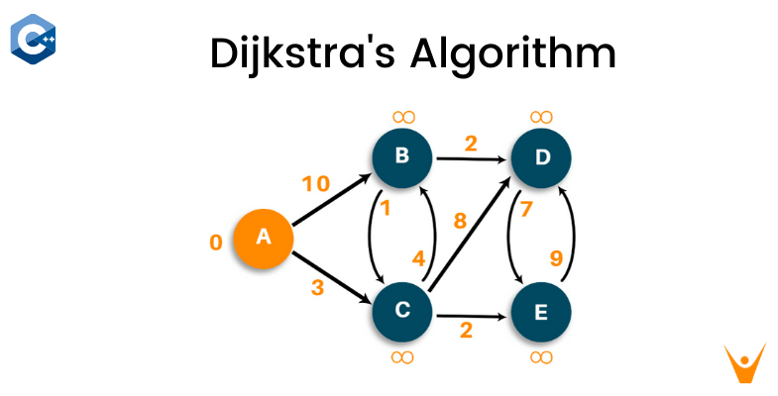
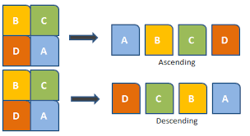

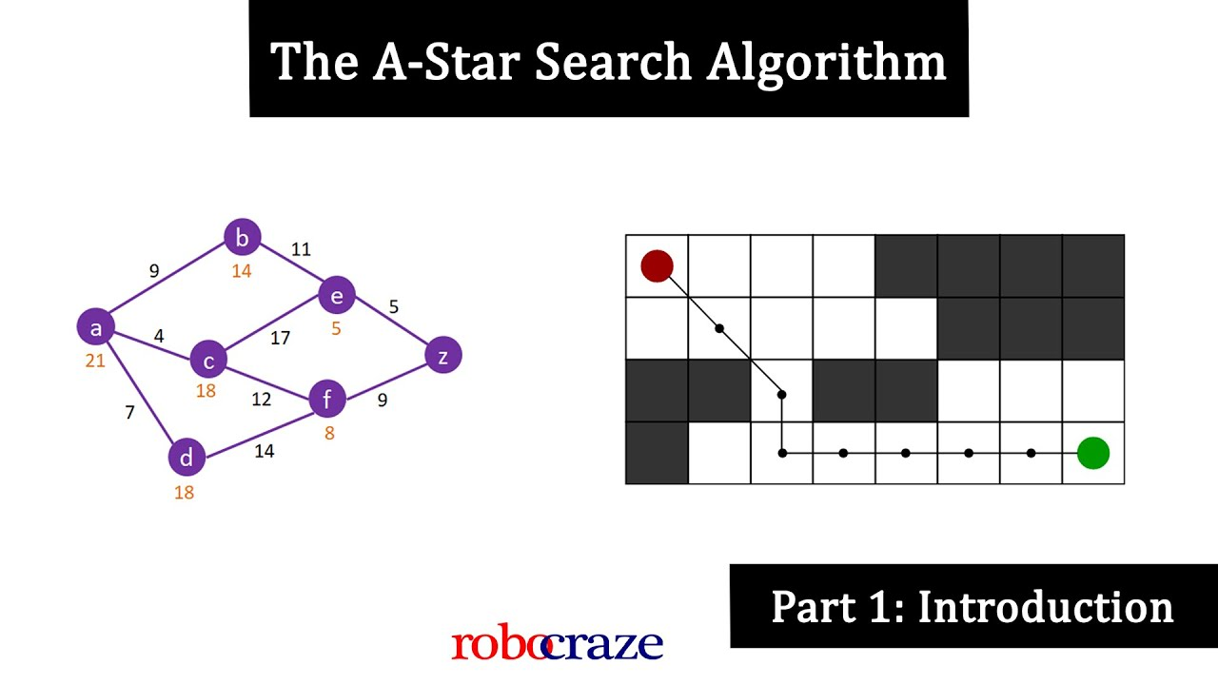
Applications of priority queues
Priority queues have numerous applications, including task scheduling, shortest path algorithms, event-driven simulations, Huffman coding, and heap sort. They are also used in network routing protocols, and in various computer science and engineering fields that require sorting and searching of elements based on their priority.
A* Algorithm

Slide 5
TYPES OF PRIORITY QUEUES
Minimum Priority Queues
Maximum Priority Queues
As the name suggests, in minimum priority queue, the element with a lower value is given a higher priority in the priority list.
For example, if we have the following elements in a priority queue arranged in ascending order like 4,6,8,9. Here, 4 is the smallest number, therefore, it will get the highest priority in a priority queue and so when we dequeue from this type of priority queue, 4 will remove from the queue and dequeue returns 4.
As the name suggests, in maximum priority queue, the element with a higher value is given a higher priority in the priority list.
For example, if we have the following elements in a priority queue arranged in descending order like 4,6,8,9. Here, 9 is the largest number, therefore, it will get the highest priority in a priority queue and so when we dequeue from this type of priority queue, 9 will remove from the queue and dequeue returns 9.
4
6
8
9
9
8
6
4
Dequeue:
Dequeue:
Notes:
Explained with heaps ahead

Slide 6
Paralysis
1
Shahid
3
Anushka
2
Abhishek
2
Front
Rear
1
2
2
3

Slide 7
Comparator or Comparable
//Syntax for declaring a priority queue
PriorityQueue<T> pq = new PriorityQueue<>(Comparator);
//pseudocode
class Patient implements Comparable<Patient>{
private int priorityNumber;
private String name;
public Patient(String name, int priorityNumber) {
// constructor to set name and priority number of a patient
this.priorityNumber = priorityNumber;
this.name = name;
}
public int compareTo(Patient pt) {
// compares priority number of a patient with the other
if(priorityNumber < pt.priorityNumber)
return -1;
else if(priorityNumber > pt.priorityNumber)
return 1;
else
return 0;
}
}
PriorityQueue(Comparator comparator) :
This creates a PriorityQueue with the specified initial capacity that orders its elements according to the specified comparator.
It compare an object of the same class with an instance of that class and provides ordering of data for objects of the user-defined class.
For example in the case of the hospital code, the Comparable interface is used to compare objects of the Patient class based on their priority numbers.

Slide 8
BASIC OPERATIONS OF A PRIORITY QUEUES
Insertion in a Priority Queue
Peek in a Priority Queue
Deletion in a Priority Queue
This operation helps to return the maximum element from Max Heap or the minimum element from Min Heap without deleting the node from the priority queue.
When a new element is inserted in a priority queue, it moves to the empty slot from top to bottom and left to right. However, if the element is not in the correct place then it will be compared with the parent node. If the element is not in the correct order, the elements are swapped. The swapping process continues until all the elements are placed in the correct position.
As you know that in a max heap, the maximum element is the root node. And it will remove the element which has maximum priority first. Thus, you remove the root node from the queue. This removal creates an empty slot, which will be further filled with new insertion. Then, it compares the newly inserted element with all the elements inside the queue to maintain the heap invariant.
Extract max/min
Extract-Max returns the node with maximum value after removing it from a Max Heap whereas Extract-Min returns the node with minimum value after removing it from Min Heap.

Slide 9
Ques. Arrange the following letters in priority queue where a letter indicates its insertion and * indicates deletion.
P
R
I
O
R
I
T
Y
Q
U
E
U
E
P
I
O
P
I
I
Q
P
R
I
I
O
I
U
I
P
I
I
O
Q
U
R
I
O
P
R
I
I
T
Q
U
E
I
O
P
R
I
I
T
E
Q
U
I
O
P
R
I
I
Y
E
Q
U
I
O
P
R
I
I
Y
Q
U

Slide 10
Ques. Write a java program to depict the implementation of priority queues and also frequently used PriorityQueue methods.
OUTPUT:
import java.util.*;
public class PQSimpler {
public static void main(String[] args) {
//Syntax for declaring a priority queue
PriorityQueue<Integer> pq = new PriorityQueue<>();
//add(): Adding elements to the priority queue
pq.add(5);
pq.add(15);
pq.add(10);
//contains(): used to check if an element is present in the queue or not
System.out.println("The queue contain the element 15: "+pq.contains(15));
System.out.println("The queue contain the element 12: "+pq.contains(12));
//peek(): returns the topmost element present in the priority queue.
System.out.println("The first element is: "+pq.peek());
//Printing out the elements of the priority queue in the priority order
//By default in java it is minimum heap/ minimum priority queue
System.out.println("The priority queue is as follows: ");
while(!pq.isEmpty()) {
//poll is used to delete the topmost element of the priority queue
System.out.println(pq.poll());
}
}
}
The queue contain the element 15: true
The queue contain the element 12: false
The first element is: 5
The priority queue is as follows:
5
10
15

Slide 11
6
1
2
4
Input (I/O) : 6 1 2 4
1
6
Add 4.
This violates the heap property(min) hence we swap the elements.
6
2
1
This violates the heap property(min) hence we swap the elements.
4
6
Add 2.
So the heap array after heapification is :
1
2
Note that this array is still not sorted
1
4
2
6
Notes:
Explaining using heaps an imp point: PQ mai jab add krte hai elements toh wo sorted nahi hote heapify hote rehte hai but jb wo remove hote hai tab wo sorted ho kr aate hai

Slide 12
6
1
2
4
Input (I) : 6 1 2 4
The heap array is :
1
4
2
6
But once we start removing/polling the elements……
1
First Poll => 1
Heapify again……
4
Second Poll => 2
4
2
Fourth Poll => 6
6
6
2
Heapify again……
6
Third Poll => 4
6
4
6
Output (O) :
1
2
4
6

Slide 13

Ques. Write a java program to print the k largest elements out of an array of N positive integers.
Understand with an example…
N = 10
k = 03
2
1
5
3
7
4
9
1
4
5
We create a PQ of three elements and insert the first three elements
Take Input: N, k and array
2
1
5
Use the operation peek on these three elements to return the smallest element (highest priority)…
Declare Priority Queue
Compare it with the next indexed element and if it is greater than the peek element replace it
Add the elements to the PQ till N is equal to k
2
3
1
5
Then if peek element of PQ < arr[i] poll the peek element and add arr[i]
Similarly with other elements till the last element and you get:
9
7
5
Print the priority queue

Slide 14
TIME COMPLEXITY OF A PRIORITY QUEUES
Array-based Priority Queue:
Insertion: Inserting an element at the end of the array takes constant time, O(1). However, if the array needs to be dynamically resized, the time complexity can become O(n), where n is the current number of elements.
Deletion: Removing the highest-priority element from the front of the array takes constant time, O(1). However, if the array needs to be reorganized to maintain the priority order, the time complexity can become O(n), where n is the current number of elements.
Peek: Finding the highest-priority element at the front of the array takes constant time, O(1).
Linked-list based Priority Queue:
Insertion: Inserting an element at the appropriate position in the linked list takes O(n) time in the worst case, where n is the current number of elements. This is because we may need to traverse the list to find the correct position for insertion.
Deletion: Removing the highest-priority element from the head of the linked list takes constant time, O(1).
Peek: Finding the highest-priority element at the head of the linked list takes constant time, O(1).
Heap-based Priority Queue:
Insertion: Inserting an element into a heap takes O(log n) time in the worst case, where n is the current number of elements. This complexity arises because the heap property must be maintained by percolating the newly inserted element up the tree.
Deletion: Removing the highest-priority element from the root of the heap takes O(log n) time in the worst case. After removing the root, the heap must be restructured by moving elements down the tree to restore the heap property.
Peek: Finding the highest-priority element at the root of the heap takes constant time, O(1).
Time Complexity
add()
poll()
peek()
Arrays
O(n)
O(n)
O(1)
Linked Lists
O(n)
O(1)
O(1)
Heap
O(log n)
O(log n)
O(1)

